Slide 1

Student Exam Performance Prediction
Supervised By: Prof. Khaled Saada
Artificial Intelligence
Team members:
Feras Mohammed
Essam Saleem
Belal Waheed
Mohammed Saber

Slide 2






SUBJECTS
Libraries & Tools
Feature Engineering
Project Overview
Data Preprocessing
Model Training & Results
Project Objectives

Slide 3


Project Overview
This project analyzes student exam data.
Focuses on predicting Pass / Fail outcomes.
Uses data preprocessing, feature engineering, and machine learning
The goal is to build a reliable classification model

Slide 4
Project Objectives
Clean and prepare raw student data
Handle missing values, duplicates, and outliers.
Engineer meaningful features.
Train and evaluate a classification model.

Slide 5

Dataset Description
The dataset represents student academic performance data.
The data is used to analyze how study behavior affects exam outcomes
Features in the Dataset:
Study Hours: Represents the number of hours a student studied before the exam
Previous Exam Score: Indicates the student’s score in a prior exam
Pass / Fail:
1 → Pass
0 → Fail

Slide 6
Libraries
NumPy: used for numerical computations and mathematical operations.
Pandas: used for data loading, manipulation, and analysis.
Matplotlib: visualization library for plotting and graphical data analysis.
Scikit-learn: machine learning library used for preprocessing, modeling, and evaluation.

Slide 7


Libraries
1. NumPy:
Used for numerical operations during feature engineering
Handled infinite values resulting from mathematical calculations
2. Pandas:
Loaded the dataset from CSV files
Removed missing values and duplicate records
Performed data cleaning and transformation
Created new features and updated existing columns

Slide 8
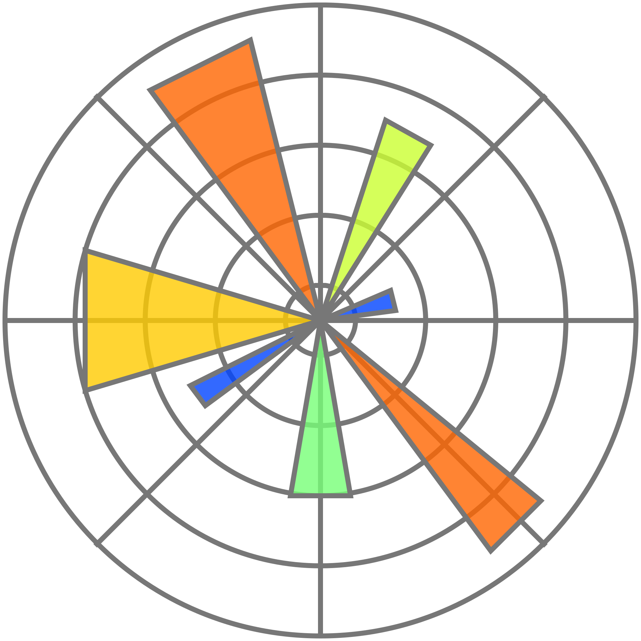
Libraries
3. Matplotlib
Visualized feature distributions using histograms
Compared Pass vs Fail outcomes visually
Helped identify trends, patterns, and data imbalance
Supported better understanding of the dataset before modeling

Slide 9

Libraries
4. Scikit-learn
Selected important features using statistical tests
Scaled features to standardize data before PCA
Reduced dimensionality using Principal Component Analysis (PCA)
Split data into training and testing sets
Trained a Logistic Regression classification model

Slide 10
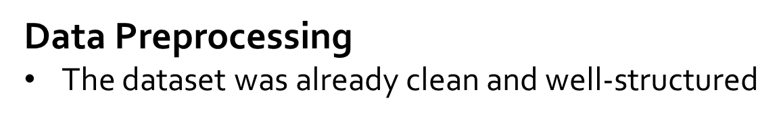
Preprocessing was still performed to:
Ensure data consistency
Avoid unexpected errors during modeling
Verifying missing values and duplicates
Confirming valid ranges for features
Handling potential outliers

Slide 11
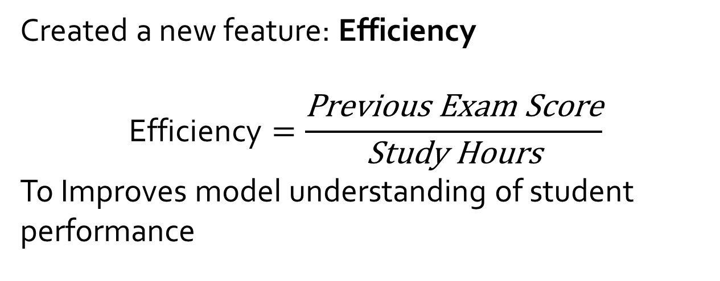
Feature Engineering
Created a new feature: Efficiency
$$\text{Efficiency}=\frac{\text{Previous} \text{Exam} \text{Score}}{\text{Study} \text{Hours}}$$
To Improves model understanding of student performance

Slide 12

Model Evaluation
Model Training & Evaluation
Logistic Regression was chosen as the classification model
Data split into training and testing sets (80% / 20%)
Model trained using engineered and selected features
Predictions made on unseen test data
Results showed effective prediction of student Pass / Fail outcomes

Slide 13
Results:
Model achieved good classification accuracy
Visualizations showed:
Clear separation between Pass / Fail
Strong relationship between exam score and outcome
Feature engineering:
improved model performance

Slide 14
Thank You

